Slide 1
SPEECH DIARIZATION AND TEXT TRANSCRIPTION
INNOVATION PRACTICES

Slide 2
Introduction
Nowadays, deep learning is being used to solve problems in inter-disciplinary areas.
Speech Processing is one such field where deep learning serves better than the canonical methods.
Conventional methods provide accuracy up to 95 %. But deep learning, when implemented will raise the accuracy up to 99%.
Two useful technologies in the handling of speech are Diarization systems, where one has to group together speech segments of the same speaker, and Transcription systems where what is said has to be transcribed.
Our aim is to built a platform capable of diarizing the speech and provide a transcription. Speech diarization categorizes the speakers models in data.

Slide 3
Need for The Project
Speaker Diarization have been a topic of research for decades. Evaluating the developed systems has been required for almost as long. The capabilities of Diarization must be tested in the presence of overlapping speech.
Our case focuses on diarization during human conversation. The systems require extending the metrics definitions and adapting the algorithmic approaches required for their implementation.

Slide 4
Objective

Slide 5
Literature Survey

Slide 6
Existing Work

Slide 7
Proposed Methodology

Slide 8
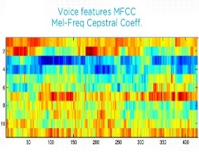
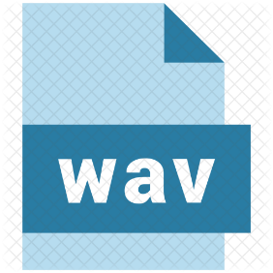
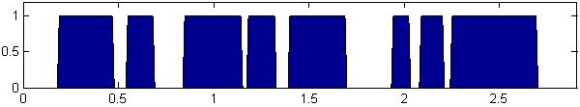
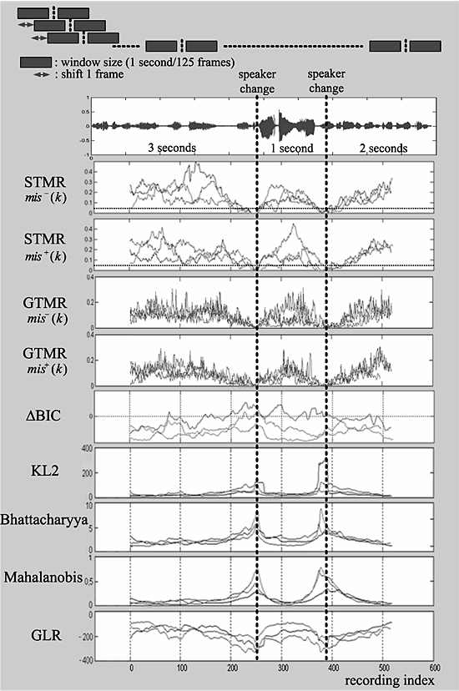
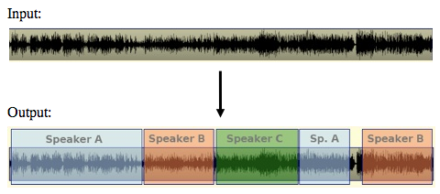

Implementation Strategy
FEATURE EXTRACTION
SPEECH ACTIVITY DETECTION
SPEAKER SEGMENTATION
CLUSTERING

Slide 10
Project Requirements
Python with Anaconda
Keras with TensorFlow

Slide 11
Timeline Chart

Slide 12
References

